Slide 1

Introduction to Python (week 4)
Louis Rey
UCSD Extension

Slide 2
Week 4 Objectives
Main Function
Error Handling
Break and Continue
File Handling
Importing modules
Introduction to Classes
The Unittest

Slide 3
Basic Error Handling and The Main Function

Slide 4
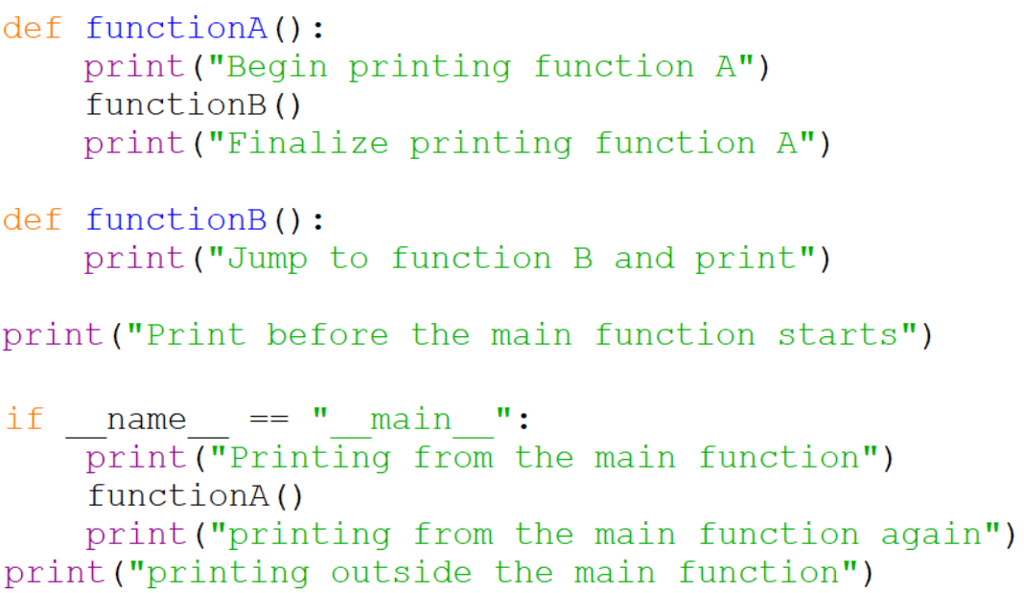
The Main Function

Slide 5
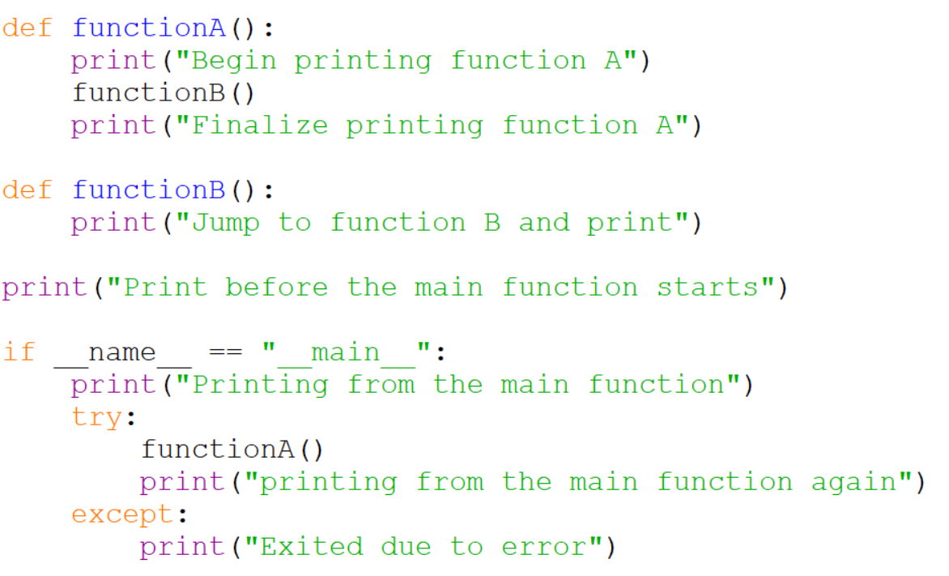
Exception Handling

Slide 6
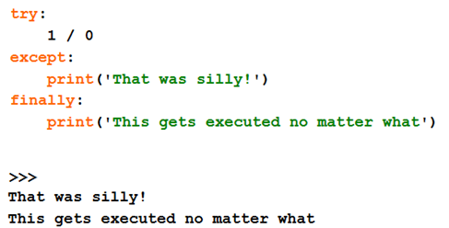
Exception Handling

Slide 7
More Options in Python

Slide 8
Break and Continue
• You can use the keyword break inside a loop to leave the while loop
entirely.
• You can use the keyword continue inside a loop to stop processing
the current iteration of the loop and to immediately go on to the
next one.

Slide 9
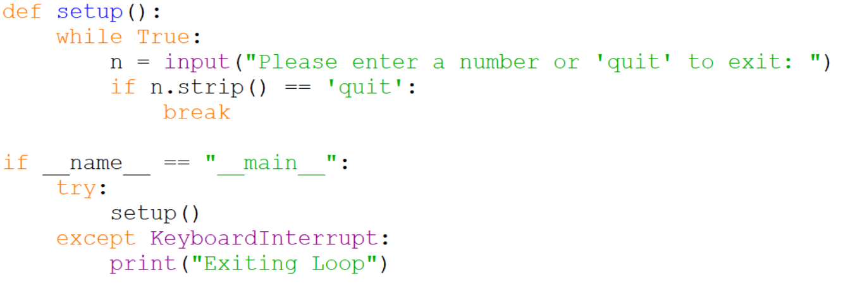
Break in an Infinite While Loop

Slide 10
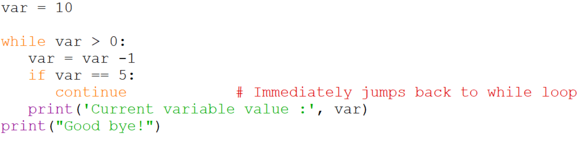
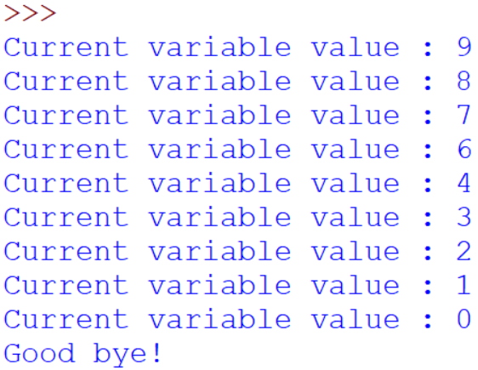
Continue in a While Loop

Slide 11
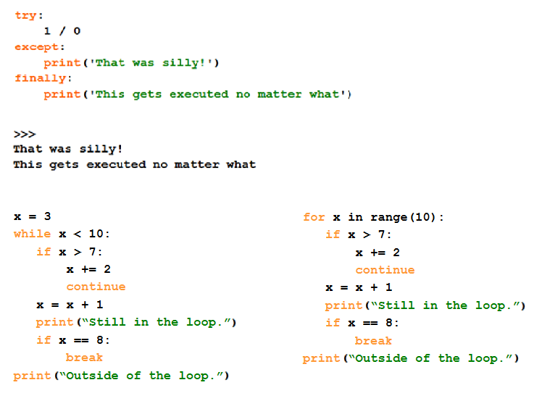
Break, Continue and Exceptions…

Slide 12
File Handling in Python

Slide 13
Opening a File
Before we can read the contents of a file, we must tell Python which file we are going to work with and what we will be doing with the file
This is done with the open( ) function
open() returns a “file handle” - a variable used to perform operations on a file
Similar to ‘File → Open’ in a Word Processor

Slide 14
Using Open ( )
handle = open(filename, mode)
Example: fhand = open(‘mbox.txt’, ‘r’)
Returns a handle used to manipulate the file
filename is a string
mode is optional and should be ‘r’ if we are planning to read the file and ‘w’ if we are going to write to the file

Slide 15
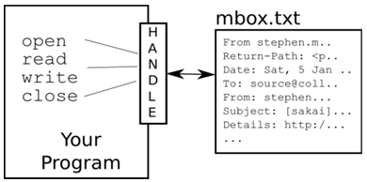
What is a Handle?
>>> fhand = open(‘mbox.txt’)
>>> print (fhand)
<_io.TextIOWrapper name=‘mbox.txt’ mode=‘r’ encoding=‘UTF-8’>

Slide 16
The newline Character
We use a special character called the ‘newline’ to indicate when a line ends
We represent it as \n in strings
Newline is still one character not two
>>> stuff = ‘Hello\nWorld”
>>> stuff
‘Hello\nWorld’
>>> print (stuff)
Hello
World
>>> stuff = ‘X\nY’
>>> print (stuff)
X
Y
>>> len (stuff)
3

Slide 17
File Processing
A text file has newlines at the end of each line
From stephen.marquard@uct.ac.za Sat Jan 5 09:14:16 2008\n
Return-Path: <postmaster@collab.sakaiproject.org>\n
Date: Sat, 5 Jan 2008 09:12:18 -0500\n
To: source@collab.sakaiproject.org\n
From: stephen.marquard@uct.ac.za\n
Subject: [sakai] svn commit: r39772 - content/branches/\n
\n
Details: http://source.sakaiproject.org/viewsvn/?view=rev&rev=39772\n

Slide 18
File Handle as a Sequence
A file handle open for read access can be treated as a sequence of strings where each line in the file is a string in the sequence
We can use the for statement to iterate through the sequence
Remember – a sequence is an ordered set
Xfile = open(‘mbox.txt’)
for choice in xfile:
print (choice)

Slide 19
Counting Lines in a File
Open a file read only access
Use a for loop to read each line
Count the lines and print out the number of lines
fhand = open(‘mbox.txt’)
count = 0
for line in fhand:
count = count + 1
print (‘Line Count: ‘. count)
>>> $ python open.py
Line count: 132045

Slide 20
Reading the *Whole* File
We can read the whole file (newlines and all) into a single string
>>> fhand = open(‘mbox.txt’)
>>> inp = fhand.read ( )
>>> print (len(inp))
94626
>>> print (inp[: 20])
From stephen.marquard

Slide 21
Searching Through a File
We can put an if statement in our for loop to only print lines that meet some criteria
fhand = open(‘mbox.txt’)
for line in fhand:
if line.startswith (‘From:’)
print (line)
The print statement will add an additional newline in addition to the ones already in existence from the file.

Slide 22
Searching Through a File (fixed)
We can strip the whitespace from the right-hand side of the string using rstrip ( ) from the string library
The newline is considered a ‘whitespace’ and is stripped
fhand = open(‘mbox.txt’)
for line in fhand:
line = line. rstrip ( )
if line.startswith (‘From:’)
print (line)
From: stephen.marquard@uct.ac.za
From: louis@media.berkeley.edu
From: zqian@umich.edu
From: rjlowe@iupui.edu
….

Slide 23
Skipping with Continue
We can conveniently skip a line by using the continue statement
fhand = open(‘mbox.txt’)
for line in fhand:
line = line. rstrip ( )
if not line.startswith (‘From:’)
continue
print (line)
Similar to the previous example but this time excludes all the lines that start with From:

Slide 24
Bad File Names
fname = input(‘Enter the file name ’)
try:
fhand = open(fname)
except:
print (‘File cannot be opened:’ , fname )
quit ( )
count = 0
for line in fhand:
if line.startswith (‘Subject:’):
count = count + 1
print (‘There were’, count , ’subject lines in’, fname)
The example above uses error trapping to catch any errors which may be input. The keywords try and except are used.

Slide 25
Importing and Modules

Slide 26
Why Use Modules?
• Code reuse
• Routines can be called multiple times within a program
• Routines can be used from multiple programs
• Namespace partitioning
• Group data together with functions used for that data
• Implementing shared services or data
• Can provide global data structure that is accessed by multiple
subprograms

Slide 27
Importing and Modules
• Use classes & functions defined in another file.
• A Python module is a file with the same name (plus the .py extension)
• Three formats of the command:
import somefile
from somefile import *
from somefile import className
What’s the difference?
What gets imported from the file and what name refers to it after it has been imported.

Slide 28
Import
import somefile
• Everything in somefile.py gets imported.
• To refer to something in the file, append the text “somefile.” to the
front of its name:
somefile.className.method(“abc”)
somefile.myFunction(34)

Slide 29
From … Import *
from somefile import *
• Everything in somefile.py gets imported
• To refer to anything in the module, just use its name. Everything in
the module is now in the current namespace.
• Caveat! Using this import command can easily overwrite the
definition of an existing function or variable!
className.method(“abc”)
myFunction(34)

Slide 30
From … Import …
from somefile import className
• Only the item className in somefile.py gets imported.
• After importing className, you can just use it without a module
prefix. It’s brought into the current namespace.
• Caveat! This will overwrite the definition of this particular name if it
is already defined in the current namespace!
className.method(“abc”) ← This was imported by this command
myFunction(34) ← This one didn’t

Slide 31


Modules and Importing
• Modules are functions and variables defined in separate files
• Items are imported using from or import
• Modules are namespaces
• Can be used to organize variable names, i.e.

Slide 32
Classes and Objects

Slide 33
What is an Object?
• A software item that contains variables and methods
• Object Oriented Design focuses on
• Encapsulation:
— dividing the code into a public interface, and a private implementation of that interface
• Polymorphism:
— the ability to overload standard operators so that they have appropriate behavior based on their context
• Inheritance:
— the ability to create subclasses that contain specializations of their parents

Slide 34
Classes
Structure:
class ClassName:
<statement-1>
.
.
.
<statement-N>
When a class definition is entered, a new namespace is created, and used as the local scope

Slide 35
Classes and Objects
Class objects support two kinds of operations: attribute references and instantiation.
class MyClass:
""" A simple example class """
i = 12345
def f (self):
return 'hello world'
Here MyClass.i and MyClass.f are attribute references
Class instantiation uses function notation
x = MyClass ( )
creates a new instance of the class and assigns this object to the local variable, x

Slide 36



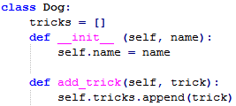

The Constructor
A constructor will set the object to an initial state when an object is first created
Class and Instance Variables

Slide 37
Public and Private Data
• In Python anything with two leading underscores is private
__a, __my_variable
• Anything with one leading underscore is semi-private, and you
should feel guilty accessing this data directly.
_b
• Sometimes useful as an intermediate step to making data private

Slide 38
Unittest

Slide 39
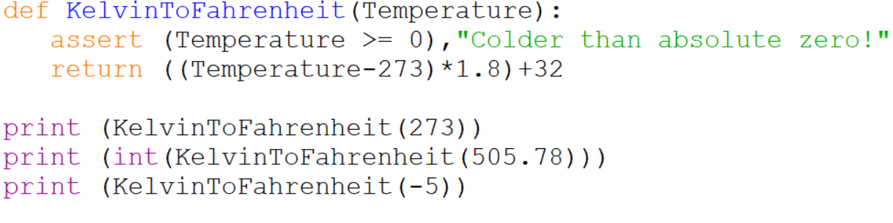
The Assert Statement
• An assertion is a sanity-check that you can turn on or turn off
when you are done with your testing of the program
assert Expression[, Arguments]
• If the assertion fails, Python uses ArgumentExpression as the
argument for the AssertionError

Slide 40
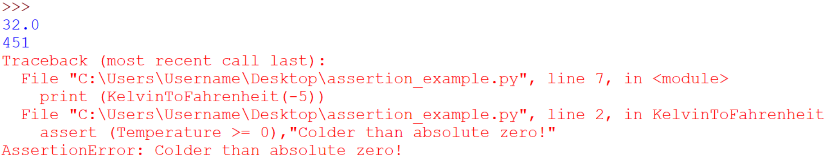
The Assert Statement

Slide 41
The Unittest
The unittest is a unit testing framework used for test automation.
Composed of:
A test fixture, which represents the preparation needed to perform one or more tests, and any associated cleanup actions
A test case, which is the individual unit of testing. It checks for a specific response to a particular set of inputs.
A unittest provides a base class, TestCase, which is a class that may be used to create new test cases
A test suite, which is a collection of test cases, test suites, or both. It is used to aggregate tests that should be executed together.
A test runner, which orchestrates the execution of tests and provides the outcome to the user

Slide 42
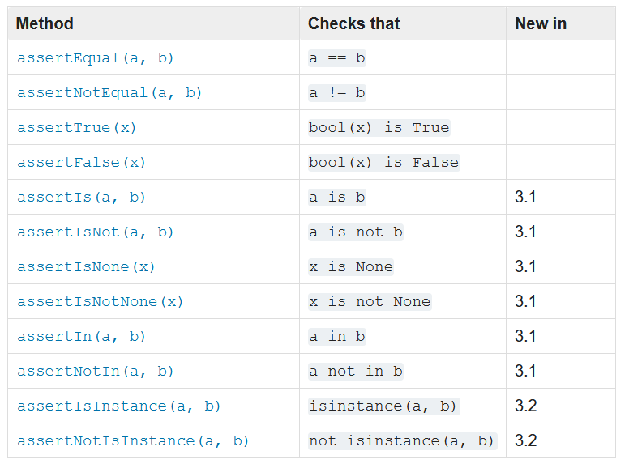
Assert Methods
The TestCase class provides several assert methods to check for and report failures

Slide 43
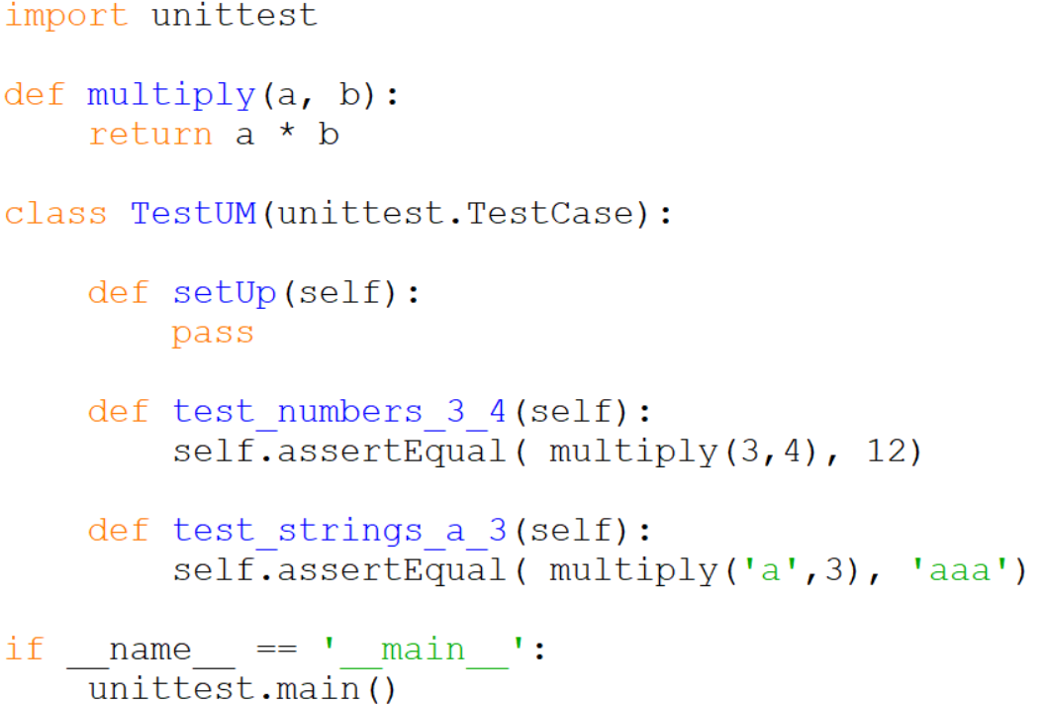
Unittest Example

Slide 44
Resources
Matt Huenerfauth (Penn State)
Guido van Rossum (Google)
Richard P. Muller (Caltech)
Bill Boyd (Weslayan University)
Smithsonian Telescope Data Center
Programming Python, Mark Lutz
Fundamentals of Python, Kenneth Lambert

